Slide 1
TRUST ME ACTION PACK
Lesson One

Slide 2
LEARNING OUTCOMES
To repeat learning points from the Trust Me film, exploring common misconceptions about gambling and providing additional opportunities for discussion.
To explore the various aspects of gambling introduced by the film, and discuss ways of practicing safer gambling.
To consider the different levels of risk associated with gambling, and understand what constitutes harm.
To understand the avenues of support that are available to someone experiencing gambling harm, as well as to those around him.

Slide 3
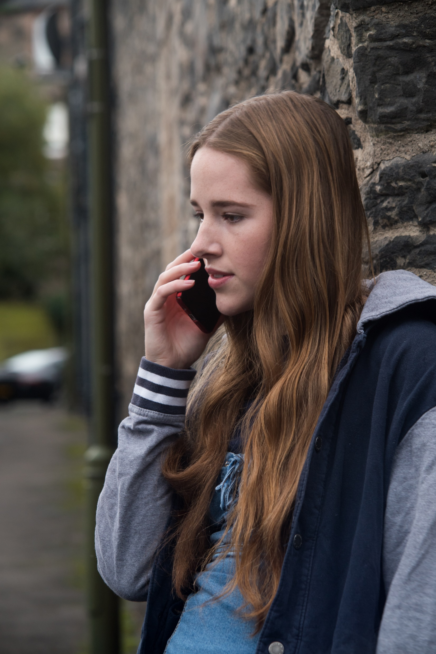
AGREE OR DISAGREE?
Do you agree with these statements, or disagree?

Slide 4
AGREE OR DISAGREE?
Jack was unlucky

Slide 5
AGREE OR DISAGREE?
Jack’s gambling only affected him

Slide 6
AGREE OR DISAGREE?
Gambling is a quick way of making lots of money if you know what you’re doing

Slide 7
AGREE OR DISAGREE?
Some forms of gambling are more addictive than others

Slide 8
AGREE OR DISAGREE?
People who win the lottery are happy for the rest of their lives

Slide 9
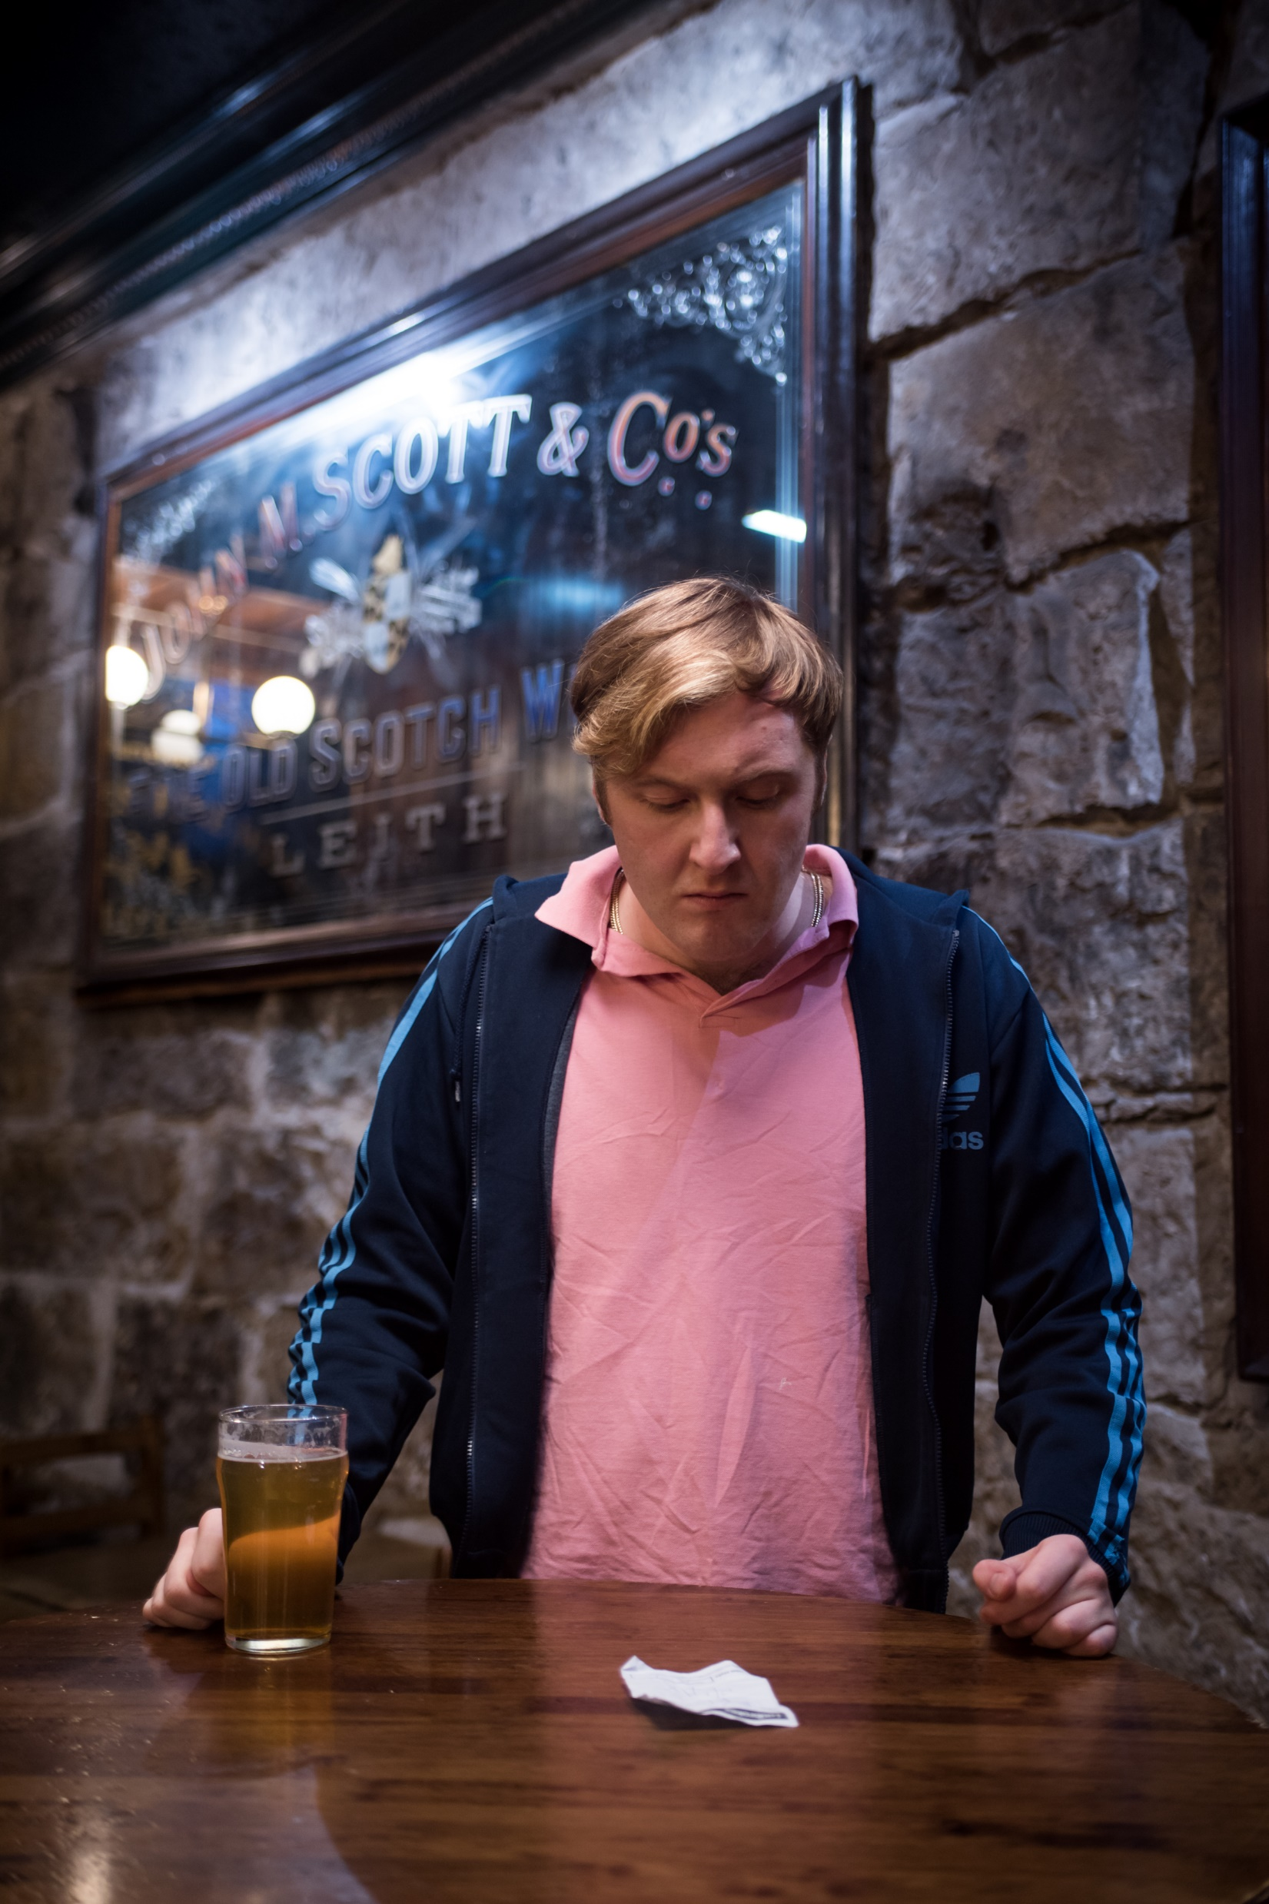
PICTURE ROUND

Slide 10
PICTURE ROUND
The following pictures show various scenes from the Trust Me film. For each picture, answer the following questions:
What happens in this scene?
What could the character(s) in the scene be feeling right now?
What advice would you give the character(s) in the picture?

Slide 11
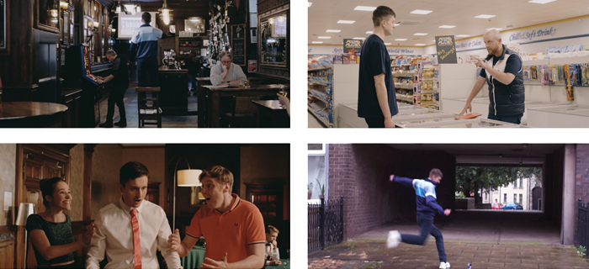
PICTURE ROUND
1
2
3
4

Slide 12
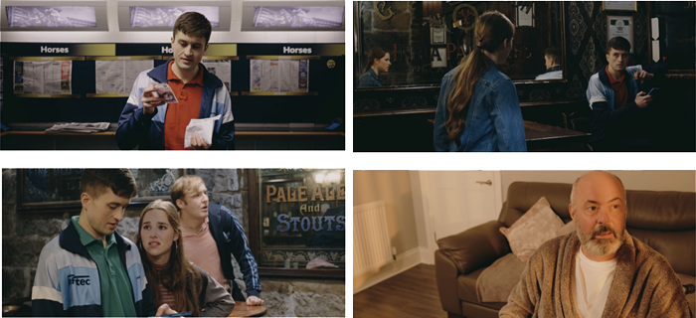
PICTURE ROUND
5
6
7
8

Slide 13
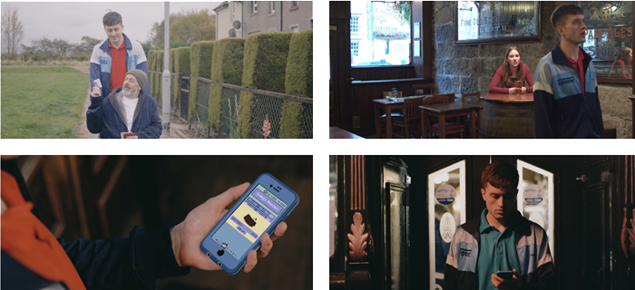
PICTURE ROUND
9
10
11
12

Slide 14
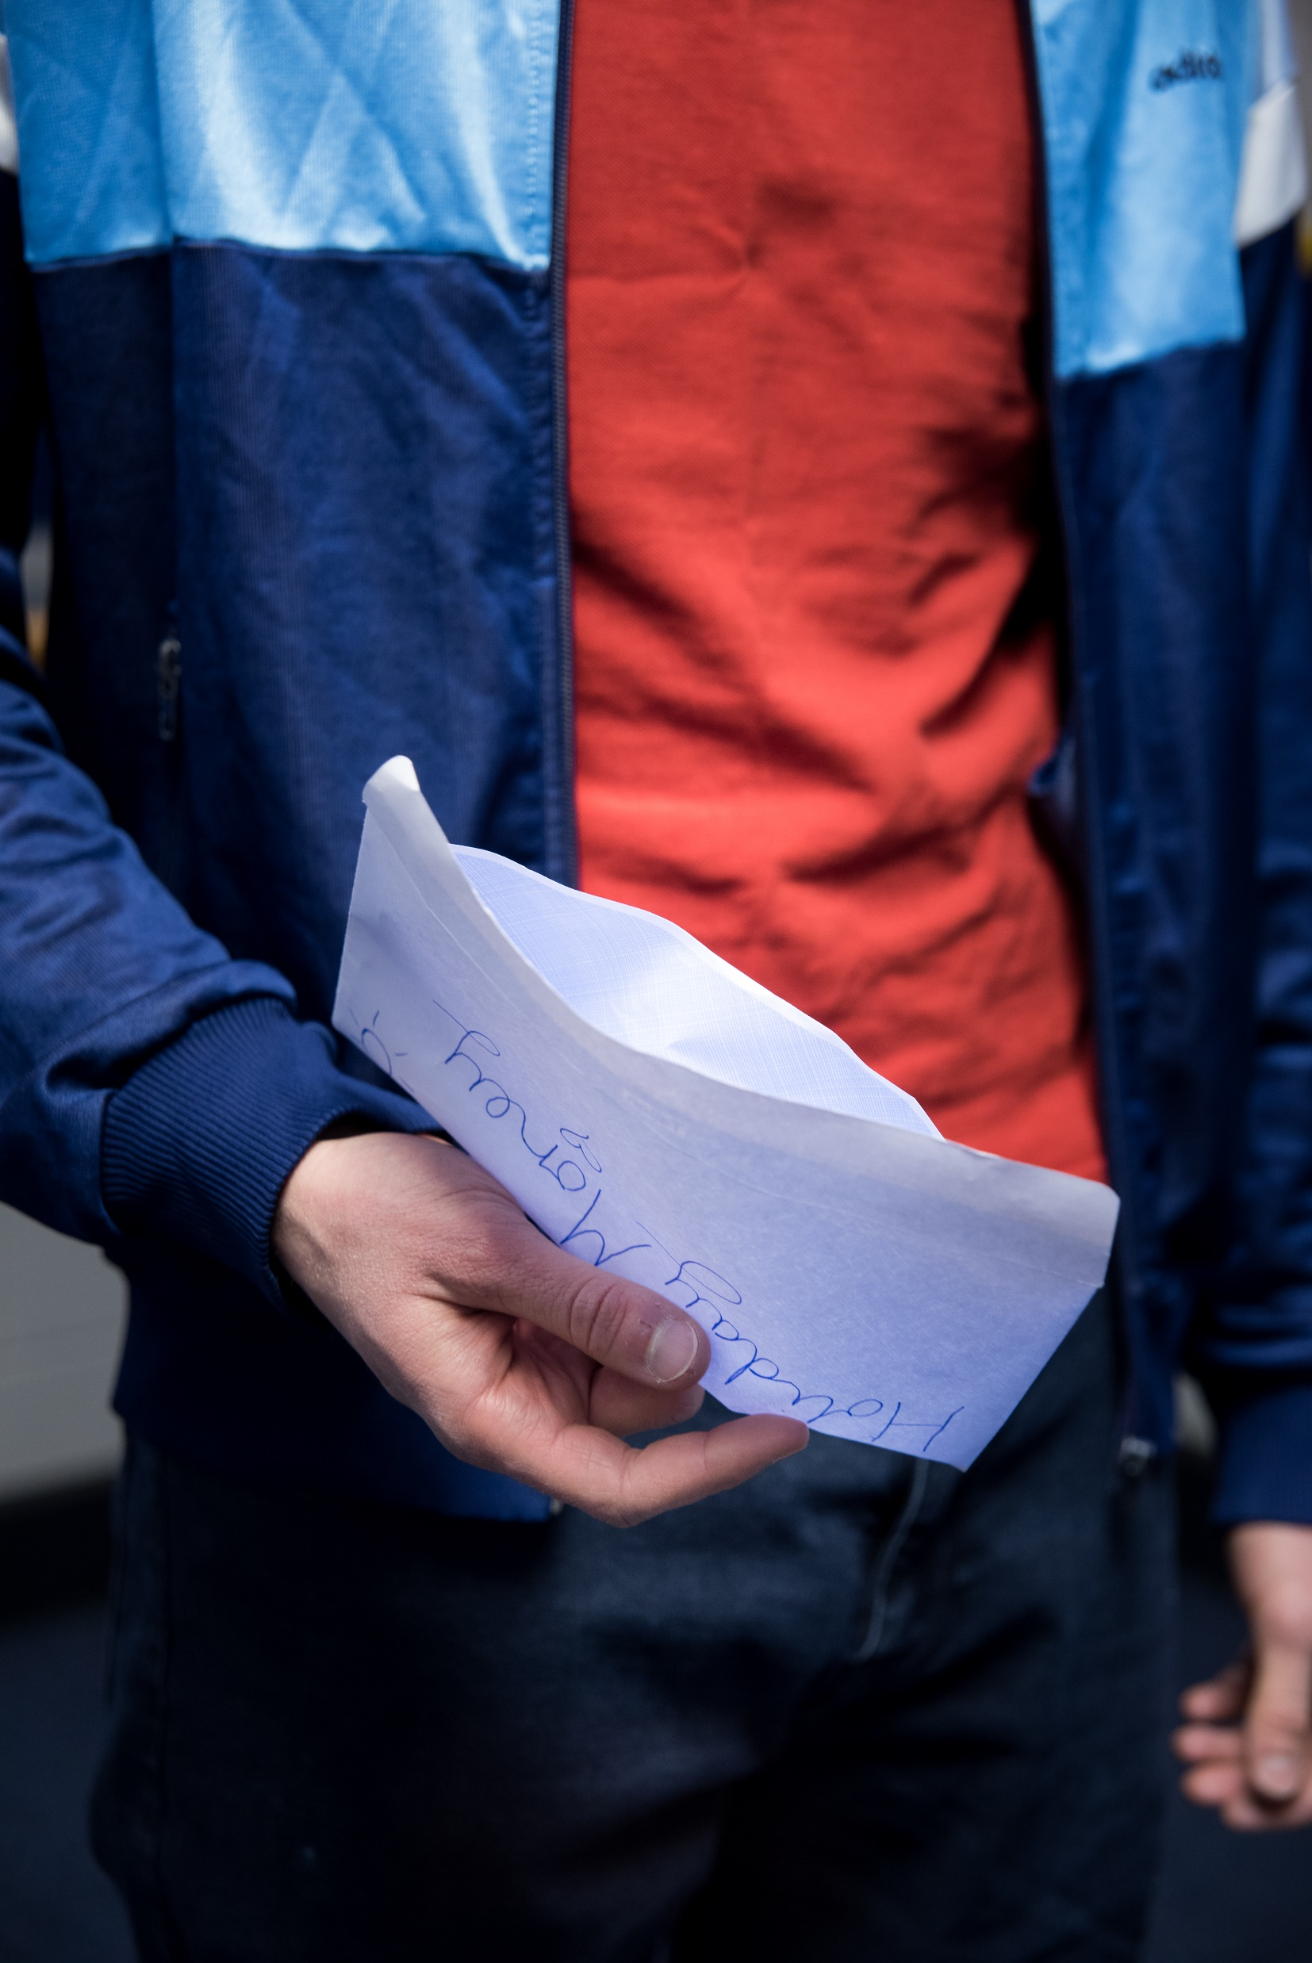
GAMBLING BEHAVIOUR LADDER

Slide 15
GAMBLING BEHAVIOUR LADDER
All gambling involves an element of risk. However, some gambling activities and behaviors may be riskier than others
Lower Risk
Higher Risk
1
2
3
4
5

Slide 16
GAMBLING BEHAVIOUR LADDER
Order these scenarios from least to most risky. Consider the frequency, stake size and motivation behind each character’s gambling.
Ryan wins £20 at the quiz machine, so he goes back with more money this time, hoping to win the Jackpot on the fruit machine.
Jack stole money from his dad to bet on a horse race, hoping he will win back the money he stole from his friends.
Becky’s gran puts £20 on the Grand National every year as a fun way of spending time with her family.
Becky and Jack flip a coin to establish who has to mop the floor.
Jack’s dad spends £2 a week on the lottery, even though he is struggling to pay his bills.

Slide 17
GAMBLING HELP
Can you think of any support that is available to someone who might be experiencing gambling harm, whether they have gambled themselves or have been affected by someone else’s gambling?

Slide 18
SUPPORT AVAILABLE
BigDeal.org.uk
Gambling information, advice
and support for young people
GamCare’s
Young People’s Service
020 3902 6964
Support for anyone aged 18 and under if they are gambling themselves, or if they are affected by someone else’s gambling.

